Slide 1

Algebra 1
Unit 4, Lesson 10 Writing Equations of Parallel Lines Volume 1, pg. 214

Slide 2


Benchmark
MA.912.AR.2.3
Write a linear two-variable equation for a line that is parallel or perpendicular to a given line and goes through a given point.
volume 1, pg. 214

Slide 3
Integrated Mathematical Thinking and Reasoning Standards
MA.K12.MTR.1.1 Actively participate in effortful learning both individually and collectively.
MA.K12.MTR.2.1 Demonstrate understanding by representing problems in multiple ways.
MA.K12.MTR.4.1 Engage in discussions that reflect on the mathematical thinking of self and others.
MA.K12.MTR.5.1 Use patterns and structure to help understand and connect mathematical concepts.
volume 1, pg. 214

Slide 4

Learning Targets
I can write the equation of a line that is parallel to a given line through a given point.
I can write the equation of a line that is parallel to a given line when given two points.
I can write the equation of a line that is parallel to a given line when given a point and the slope.
volume 1, pg. 214

Slide 5

Warm-Up
volume 1, pg. 214

Slide 6
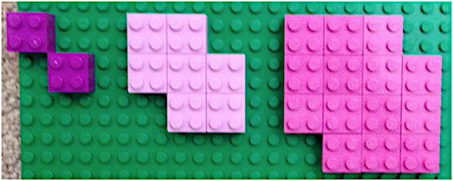
4.10.1 Warm-Up: Lego Pattern
What do you notice about the pattern?
Draw the next set of blocks in the pattern.
volume 1, pg. 214
Notes:
Video Link: https://algebranation.wistia.com/medias/fi4fidi5y8

Slide 7
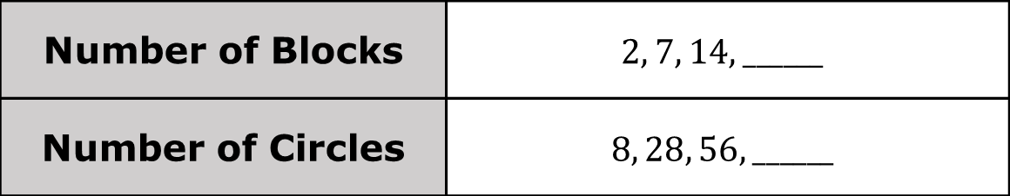
Complete the two different ways of writing the pattern.
Number of Blocks | $$2, 7, 14, ______$$
Number of Circles | $$8, 28, 56, ______$$
volume 1, pg. 214

Slide 8

Collaboration
volume 1, pg. 215

Slide 9

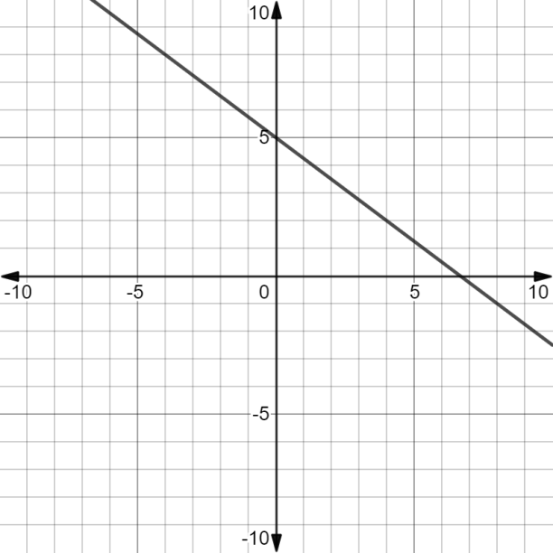

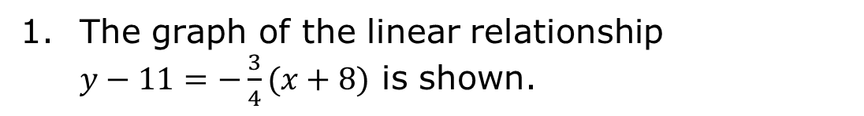
4.10.2 Collaboration: Parallel Lines
The graph of the linear relationship $y−11=−\frac{3}{4}(x+8)$ is shown.
Lines are parallel if the slopes of the lines are the same.
volume 1, pg. 215

Slide 10
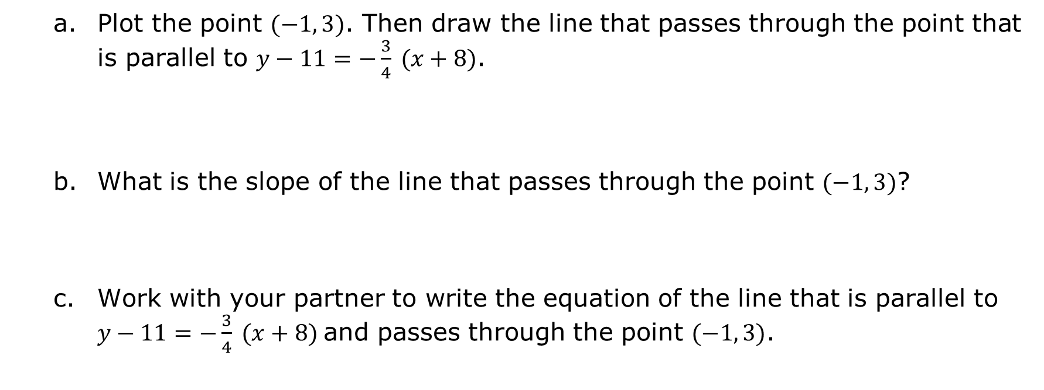
Plot the point $(−1, 3)$. Then draw the line that passes through the point that is parallel to $y−11=−\frac{3}{4} (x+8)$.
What is the slope of the line that passes through the point $(−1, 3)$?
Work with your partner to write the equation of the line that is parallel to $y−11=−\frac{3}{4} (x+8)$and passes through the point $(−1, 3)$.
volume 1, pg. 215

Slide 11
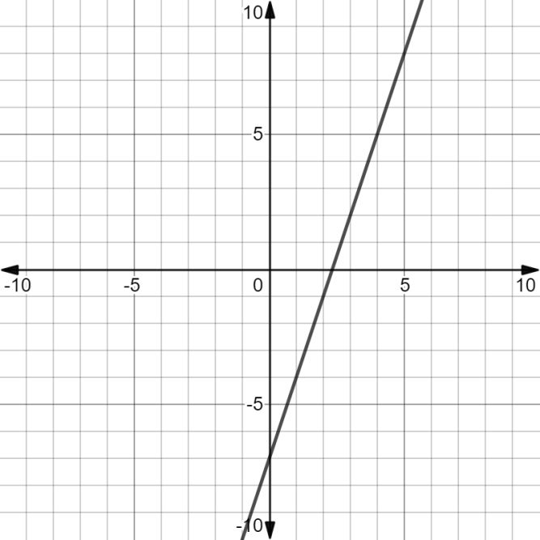
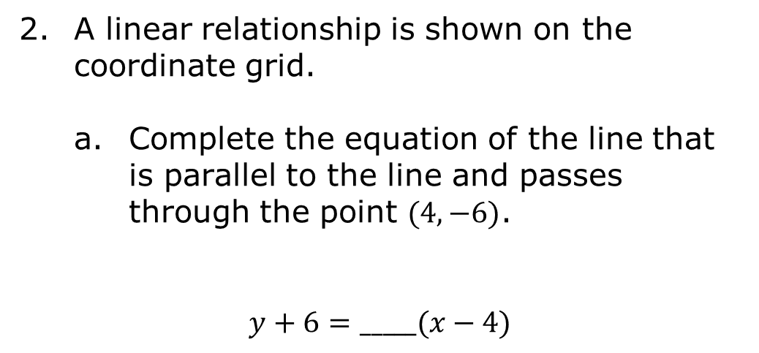
A linear relationship is shown on the coordinate grid.
Complete the equation of the line that is parallel to the line and passes through the point $(4, −6)$.
$$y+6=_____(x−4)$$
volume 1, pg. 215

Slide 12
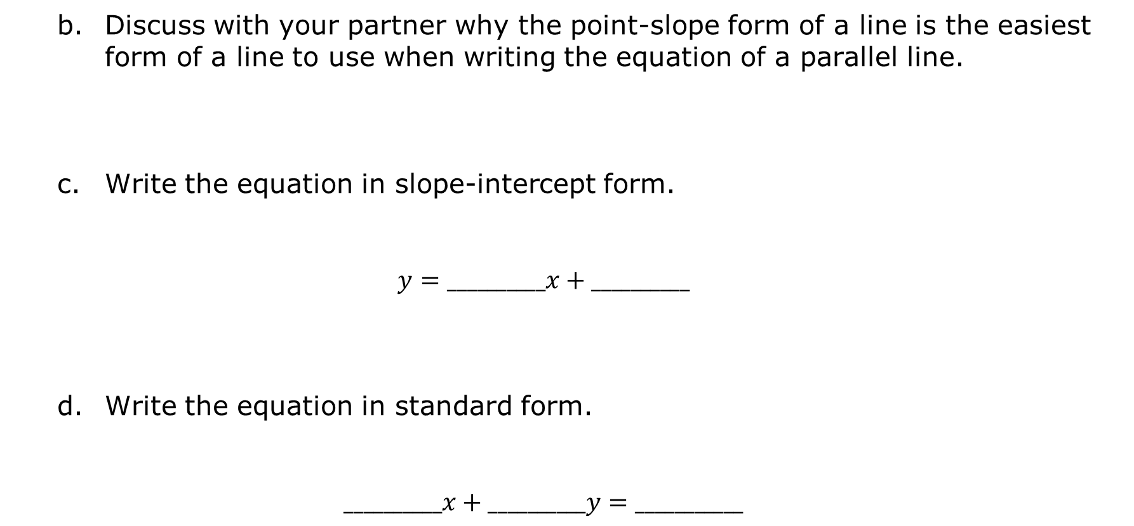
Discuss with your partner why the point-slope form of a line is the easiest form of a line to use when writing the equation of a parallel line.
Write the equation in slope-intercept form.
$$y=__________x+__________$$
Write the equation in standard form.
$$__________x+__________y=___________$$
volume 1, pg. 216

Slide 13
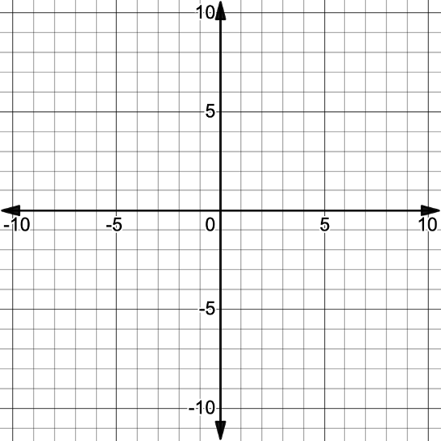
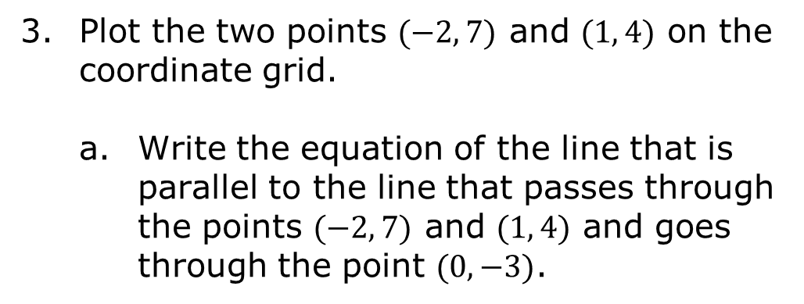
Plot the two points $(−2, 7)$ and $(1, 4)$ on the coordinate grid.
Write the equation of the line that is parallel to the line that passes through the points $(−2, 7)$ and $(1, 4)$ and goes through the point $(0, −3)$.
volume 1, pg. 216

Slide 14
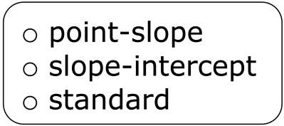
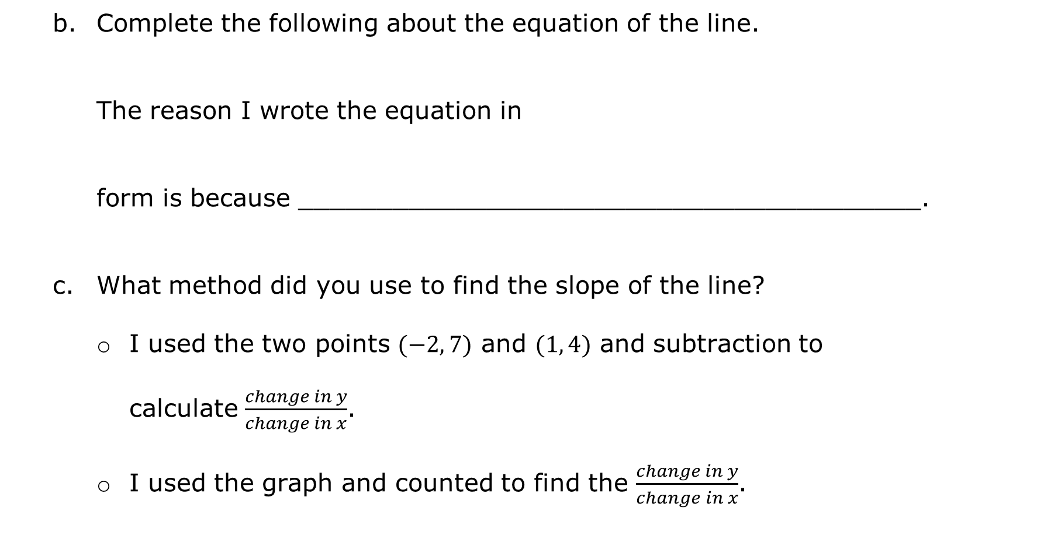
Complete the following about the equation of the line.
The reason I wrote the equation in
form is because ________________________________________.
What method did you use to find the slope of the line?
I used the two points $(−2, 7)$ and $(1, 4)$ and subtraction to calculate $\frac{change in y}{change in x}$.
I used the graph and counted to find the $\frac{change in y}{change in x}$.
volume 1, pg. 217

Slide 15

Guided Instruction
volume 1, pg. 217

Slide 16

4.10.3 Guided Instruction: Parallel Lines
Write the equation of the line, in all three forms, that is parallel to the line that passes through the points $(−5, −2)$ and $(−3, 2)$ and goes through the point $(7, −1)$.
Point-Slope Form | Slope-Intercept Form | Standard Form
volume 1, pg. 217

Slide 17
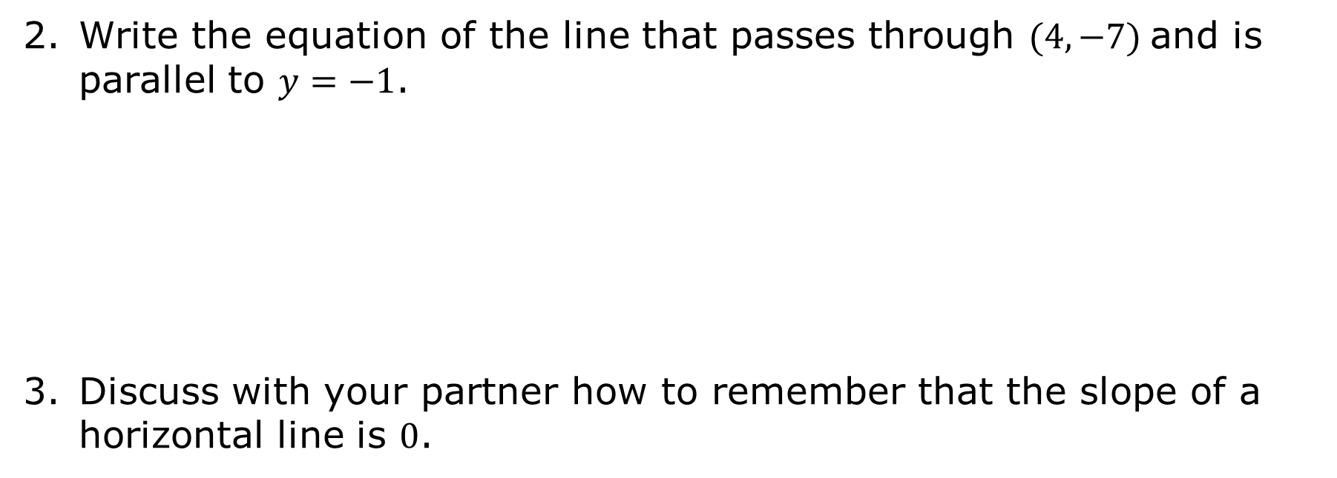
Write the equation of the line that passes through $(4, −7)$and is parallel to $y=−1$.
Discuss with your partner how to remember that the slope of a horizontal line is $0$.
volume 1, pg. 217

Slide 18

Write the equation of the line that passes through $(4, −7)$ and is parallel to the line that passes through the points $(−1, −2)$ and $\left(−1, 6\right).$
With your partner, discuss how to remember that the slope of a vertical line is undefined.
volume 1, pg. 218

Slide 19
Complete the table.
Type | Sketch | Slope | Equations of Parallel Lines
Horizontal Line
Vertical Line
volume 1, pg. 218

Slide 20
Write the equation of the line, in all three forms, that is parallel to the line $−12x+15y=45$and goes through the point $(−9, 14)$.
Point-Slope Form | Slope-Intercept Form | Standard Form
volume 1, pg. 218

Slide 21

Your Turn
volume 1, pg. 219

Slide 22
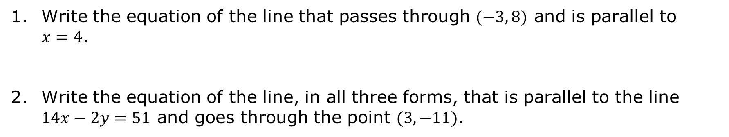
4.10.4 Your Turn!
Write the equation of the line that passes through $(−3, 8)$ and is parallel to $x=4$.
Write the equation of the line, in all three forms, that is parallel to the line $14x−2y=51$ and goes through the point $(3, −11)$.
Point-Slope Form | Slope-Intercept Form | Standard Form
volume 1, pg. 219

Slide 23

Wrap-Up
volume 1, pg. 219

Slide 24
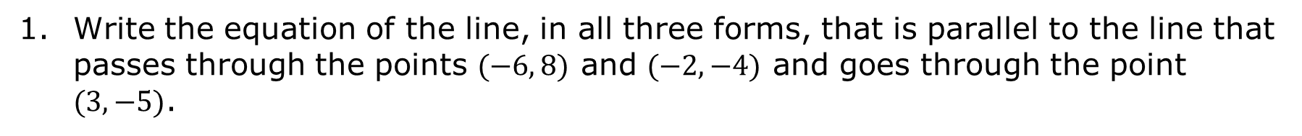
4.10.5 Wrap-Up: Cool Down
Write the equation of the line, in all three forms, that is parallel to the line that passes through the points $(−6, 8)$ and $(−2, −4)$ and goes through the point $(3, −5)$.
Point-Slope Form | Slope-Intercept Form | Standard Form
volume 1, pg. 219

